Slide 1
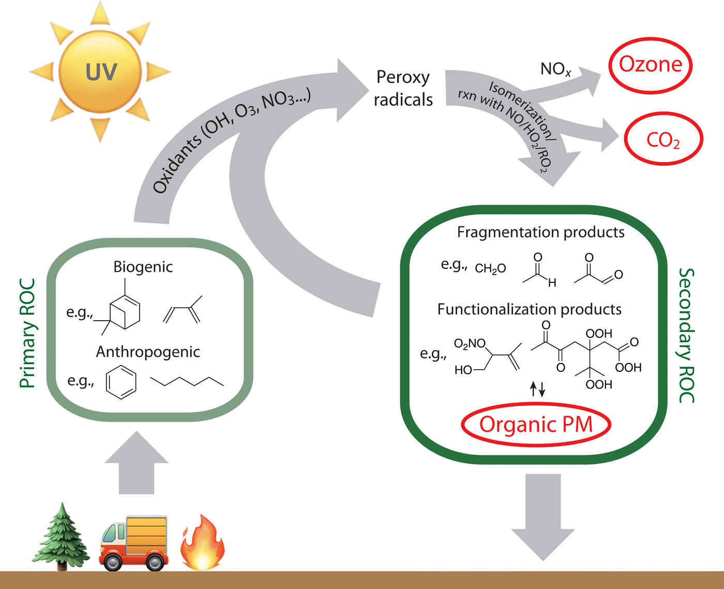
Atmospheric Chemistry: Gas Phase Chemistry of the Troposphere
ATM 505
Spring 2023
Jie Zhang Lecture 2

Slide 2
Troposphere Introduction
Photochemical Oxidation
Earth has an oxidizing atmosphere. Large complex molecules that are emitted into the atmosphere are oxidized and broken down. Smaller molecules (either reduced, or not fully oxidized) are also oxidized. (Aerosols are also oxidized, and aerosol oxidation is a newer and very active field of study.)
Oxidation
Oxidized gas/
aerosol
Reduced gas
EARTH
SURFACE
Emission
Deposition
Reduction

Slide 3
Primary and Secondary Pollutants
Troposphere Introduction
Primary pollutants are directly emitted, generally from the surface, and often (but not always) as the result of human activity.
Primary pollutant emissions include NO_{x} (NO+NO₂), VOCs (volatile organic carbon species), SO₂, some fraction of PM, and more.
Secondary pollutants are produced in the atmosphere as the result of (photo) chemical reactions.
Examples are O₃, many kinds of inorganic and organic secondary aerosols

Slide 4
Key Gas Phase Chemical Species
Troposphere Introduction
Ozone (O₃) – has roles as oxidizer, radical source, and pollutant. Low levels of O₃ (either transported from the stratosphere or produced in-situ) are crucial to the cleansing of the troposphere. High levels of tropospheric O₃ are a problem (they can be harmful to humans, animals and plants). Ozone is (mainly) a secondary product of oxidation reactions.
Hydroxyl radical (OH) – is an extremely reactive free radical and the primary oxidizer in the troposphere. Some call it “the key to understanding atmospheric chemistry” and/or “the vacuum cleaner of the atmosphere”. OH is created (and rapidly destroyed) by photochemical reactions.
NO_{X} = NO + NO₂ – more than any other set of species, NO_{X} defines the “regime” of the atmosphere (i.e., remote, clean, polluted). The regime has important consequences when we decide how to control the pollution at a given location. NO_{x} is a source gas (pollutant).
VOCs – Volatile Organic Carbon species – a wide array of reduced compounds, emitted from natural sources or as a result of human activity (anthropogenic). VOCs are also source gases (pollutants).

Slide 5
Sources of Tropospheric O₃
Reactive Gases- Tropospheric Ozone
Transport from the stratosphere ~ 1±.2 x 10¹³ moles/year
Photochemical production ~ 10±2 x 10¹³ moles/year
Rule of thumb is that ~10% (maybe more) of tropospheric ozone is from the stratosphere

Slide 6
Photochemical Sources of O₃
Reactive Gases- Tropospheric Ozone
The dominant source of odd oxygen (i.e., ozone) in the stratosphere is
  O₂ + hν → O + O this source is not important in the troposphere because the photons with enough energy to break the O₂ bond are gone before they reach the troposphere, so
The dominant photochemical ozone source in the troposphere is
  NO₂ + hν → NO + O followed by
  O + O₂ + M → O₃ + M
So NO₂ is the immediate precursor for ozone, so we “watch for sources” of NO₂

Slide 7
Troposphere vs. Stratosphere
Reactive Gases- Tropospheric Ozone
 | Stratosphere (Ozone necessary for human and other higher life forms) | Troposphere (High levels of ozone harmful to humans and ecosystems)
Photolytic Ozone source | O₂ + hν | NO₂ + hν
Ozone mixing ratio | 1-10 ppm or 1000-10,000 ppb | Average 35 ppb
O atom concentration | 10⁵-10⁹ molecules cm⁻³ | ~10³-10⁴ molecules cm⁻³
Ozone perturbations | Pollutants destroy ozone via catalysis | Pollutants lead to ozone formation (as a byproduct of oxidation)

Slide 8
Tropospheric Photochemical Steady State or Leighton Relation
Reactive Gases-Tropospheric Ozone
  NO₂ + hν → NO + O; k₁ (1st order)
  O + O₂ + M → O₃ + M; k₂ (3rd order)
  NO + O₃ → NO₂ + O₂; k₃ (2nd order)
  (If NO reacts with other species – and it does, this relation is not strictly correct - but it is a very good starting point.)

Slide 9
Emissions for Reactive Gases (and precursors of reactive gases)
Reactive Gases Emission
Occur almost entirely at the surface
Some natural sources, including geologic, biogenic, “natural” forest fires
Human caused or anthropogenic sources, including combustion, transportation, industrial, oil & gas mining, etc. These emissions are “air pollution”.

Slide 10
What happens to these emissions?
Reactive Gases Emission
Left to its own devices, the atmosphere can cleanse itself (by breaking down gases into simpler and safer forms)
If continually challenged by air pollution, the atmosphere becomes polluted and air quality (and human health) suffers
A lot of focus is aimed toward secondary ozone (and particulate matter) produced as a result of air pollution emissions

Slide 11
Regimes (or States) of Atmospheric Chemistry are determined by the magnitude of reactive gas emissions.
Reactive Gases Emission Regimes
Low emissions regime → Background or Remote Atmosphere (example: remote oceanic locations)
  Very Low
  Low to Moderate
High emissions regime → Polluted Atmosphere (Question: where they are mainly located now?)
We will try to develop each of these regimes a bit - focusing on the role of NO_{x} (= NO + NO₂)

Slide 12
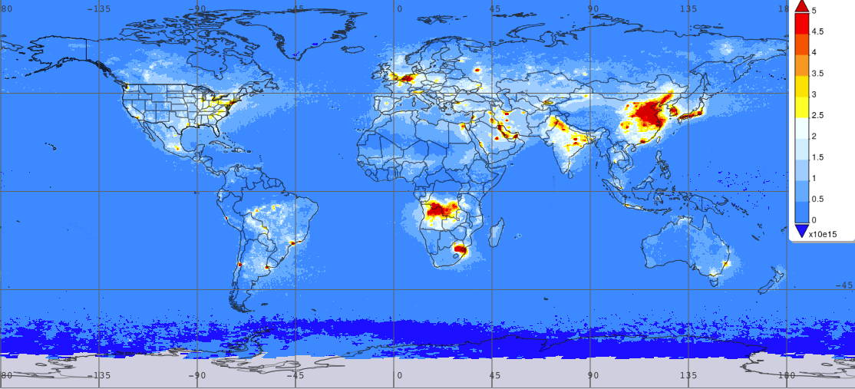
Reactive Gases Emission Regimes
https://giovanni.gsfc.nasa.gov/giovanni/,
June-Aug. 2019 OMI Satellite column concentration (molecules/cm²) (vs. mixing ratio?)
High emissions regime examples: most urban locations, esp. Asia, Africa, middle east, etc.

Slide 13
Low NOx emissions regime chemistry
OH is the primary oxidizing species, and the ubiquitous and primary source of OH is from O₃ photolysis
O₃ + hν → O(¹D) + O₂ followed by
O(¹D) + H₂O → 2 OH
For background conditions:
~ 41% of OH reacts with CO (normally 50-200 ppb; source: fuel combustion, open fires, VOC oxidation)
~ 14% of OH reacts with CH₄ (1700-1900 ppb; source: wetlands, oil/gas production, landfills, etc, will be discuss later)
This establishes CO and CH₄ as the species that govern the background chemistry of the troposphere

Slide 14
CO Oxidation Mechanism
Low NOx emissions regime chemistry
Pretty common situation over non-urban continental locations
Question: how about the very remote region with much low NO?
This set of reactions reforms the OH and NO reactants and produces ozone
This reaction sequence can be very efficient!

Slide 15
Very Low NO_{x} - Background Troposphere
Low NOx emissions regime chemistry
Not much around in terms of “pollution”, so HO₂ reacts with O₃ to reform OH and destroy O₃
  HO₂ + O₃ → OH + 2O₂
This leads to a net destruction of ozone during the oxidation process
This regime is uncommon, at least over continental regions, because anthropogenic sources of NO_{x} nearly always produce enough NO (i.e., pollution) to react rapidly with HO₂ (“Low/Moderate NO_{x} Regime”)
VS.
Very Low NO_{x} Regime (remote ocean)
Ozone loss
Low/Moderate NOx Regime (un-urban)
Ozone production

Slide 16
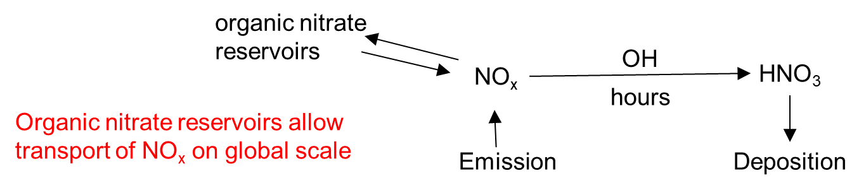
High NOx emissions regime chemistry
Most of the same reactions as in the low-moderate NO_{x} case
But in this case radicals are lost, and ozone production is interrupted when
  OH + NO₂ + M → HNO₃ + M
One can see that increasing NO_{x} in this case can limit ozone production (or even decrease it)

Slide 17
Basic Concept Recap
High NOx emissions regime chemistry
Secondary production of ozone via chemical and photochemical oxidation reactions is a major focus of tropospheric gas phase photochemistry
Critical species in this chemistry (aside from the compound being oxidized) are HO_{x} and NO_{x} radicals (HO_{x} = OH + HO₂, NO_{x} = NO + NO₂)

Slide 18
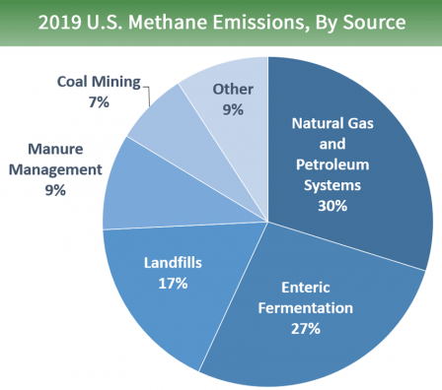
Methane Photooxidation
Methane (CH₄) is a simple molecule, but its oxidation chemistry can get pretty complex. The reactions themselves are not too complicated, but there are many branch points and possible reaction channels.
Methane is also a greenhouse gas, second-most anthropogenic greenhouse gas (after CO₂) for its effect on radiative forcing

Slide 19
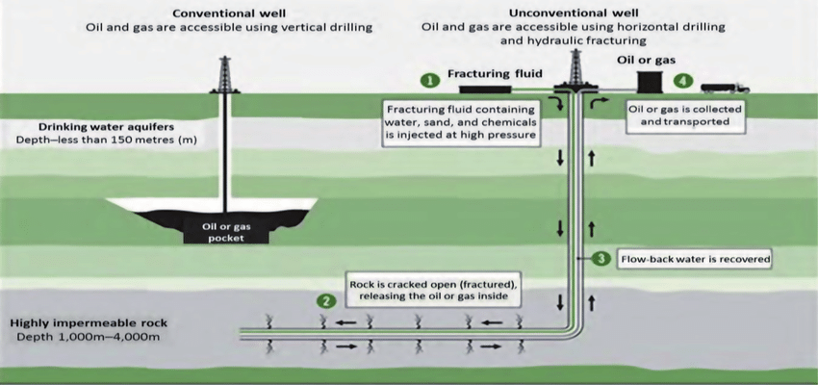
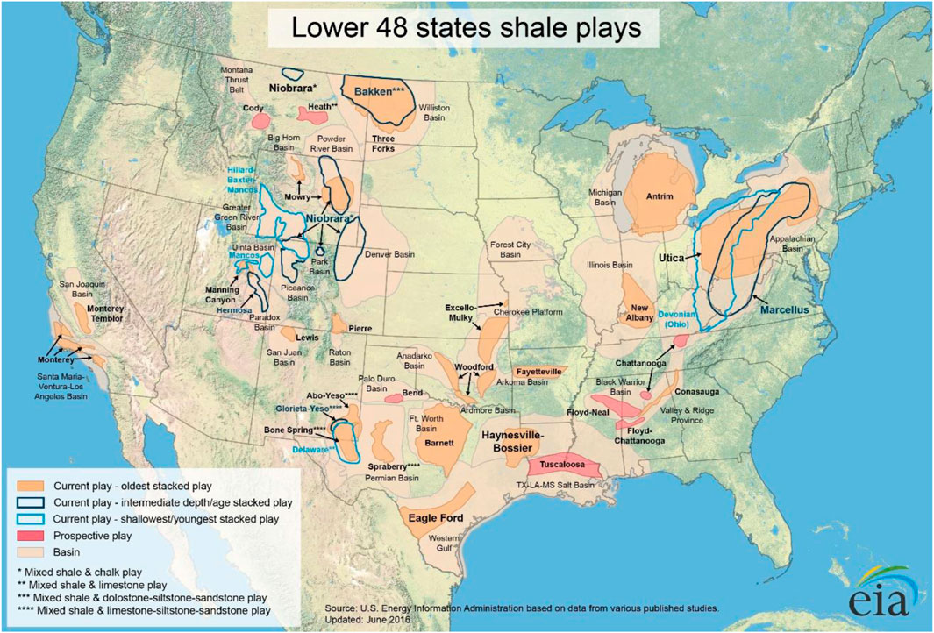
Methane Photooxidation: Sources
Unconventional oil and natural gas (UONG) development in the shale basins
Non-methane volatile organic compounds from UNG production with methane, and contain toxic compounds (benzene, toluene, ethylbenzene, and xylenes (BTEX))
BTEX is reported to be as high as 500 ppb downwind of the UONG well. (Zimmerle et al., 2017)
Ref.: Zimmerle, D. J (2017). Gathering pipeline methane emissions in Fayetteville shale pipelines and scoping guidelines for future pipeline measurement campaigns. Elem. Sci. Anthropocene

Slide 20
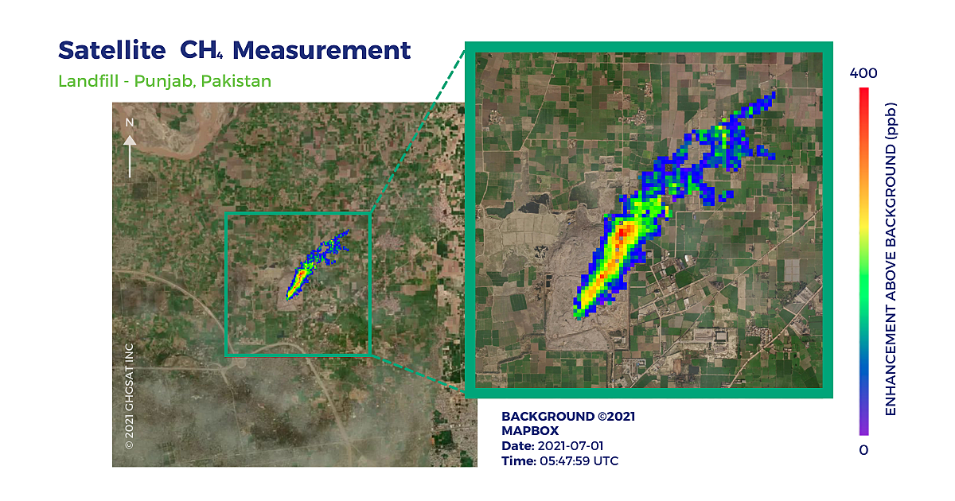

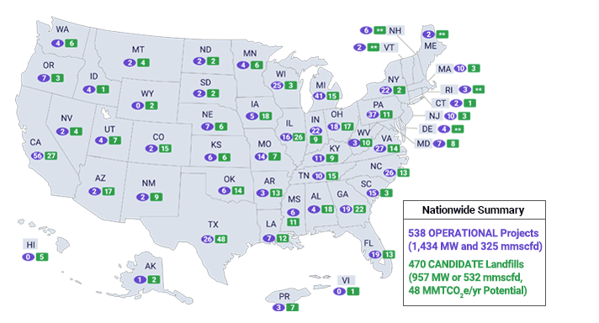

Methane Photooxidation: Sources
Landfills: name several landfills?
Not only CH4, also H₂S and other species from Landfills.
https://www.epa.gov/lmop/project-and-landfill-data-state
https://www.ghgsat.com/en/case-studies/landfill-gas/

Slide 21
Methane Oxidation – Extreme Case #1
Methane Photooxidation: Two extreme cases
High (or at least sufficient) NO_{X} regime – typical to moderate and highly polluted conditions
  Tweak reactions such that HO₂ (and CH₃O₂) react only with NO
  Tweak all photodissociation reactions to yield the most reactive products (not realistic – academic exercise only)
  Sum all the selected reactions to arrive at
NET: CH₄ + 10O₂ → CO₂ + H₂O + 5O₃ + 2OH
  Overall yield – 5 ozone molecules and 2 HO_{X} radicals. These are byproducts of the oxidation reactions.
  This is a bad situation if you are trying to control ozone production and concentration!

Slide 22
Methane Photooxidation: Two extreme cases
Methane Oxidation – Extreme Case #2
Very low NO_{X} regime – found in very remote (or clean) areas and some ocean locations
  CH₃O₂ reacts with HO₂ and/or itself (plausible)
  Photolysis reactions producing radicals are shut down
  Sum all these selected reactions to arrive at
NET: CH₄ + 3OH + 2O₂ → CO₂ + 3H₂O + HO₂
  Overall – no ozone is produced and 2 HO_{X} radicals are consumed.
  Once again we see that NOX is critical to the production of O3 and to maintaining OH concentrations.

Slide 23

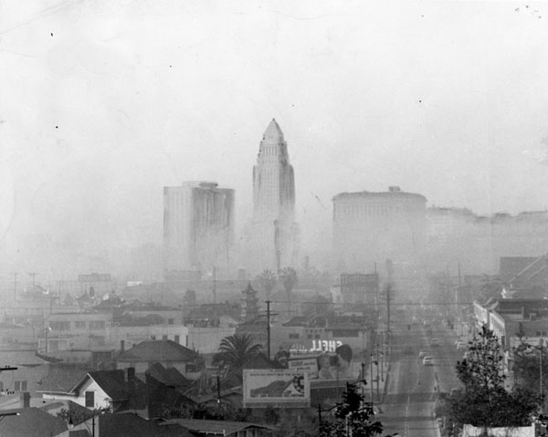
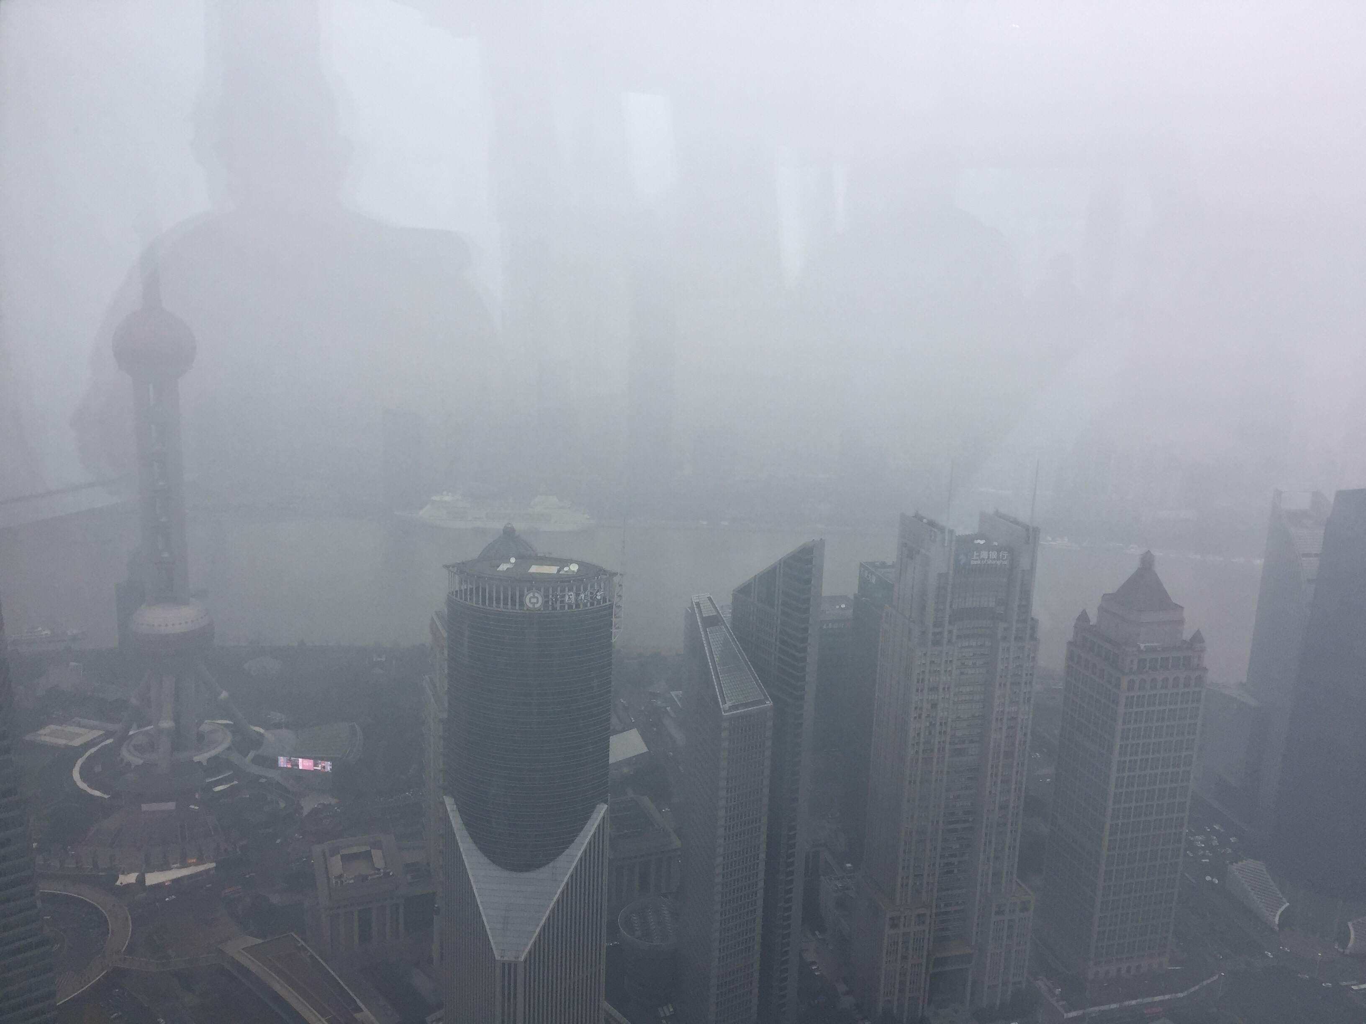
Air Pollution Chemistry
One can define air pollution as the human influenced release of chemicals into the atmosphere.
These emissions perturb the natural or background chemical processing of reactive gases (that is, the cleansing caused by oxidation reactions).
Air pollution can be controlled.
Air pollution chemistry and air quality management are important aspects of atmospheric chemistry.
1950s London
1960s NYS
2010s Shanghai

Slide 24
Polluted Atmosphere Photochemical Oxidation
Air Pollution Chemistry
Also called “Air Pollution Chemistry”
In this situation, there is always sufficient NO_{x}, so the very low NO_{x} regime is ignored, and there is always ozone production
The question becomes, how fast and how efficiently is ozone produced?
OH still reacts with CO and CH₄, but now other Volatile Organic Carbon (VOC) compounds dominate the OH reactivity

Slide 25
VOCs and NO_{x}
Air Pollution Chemistry
Vast numbers of different VOC compounds (thousands?, more?)
Maybe 100 or so are routinely measured
In polluted conditions the anthropogenic emissions dominate, but biogenic emissions are also important
NO_{x} in polluted environments comes mainly from fossil fuel combustion, including motor vehicles

Slide 26
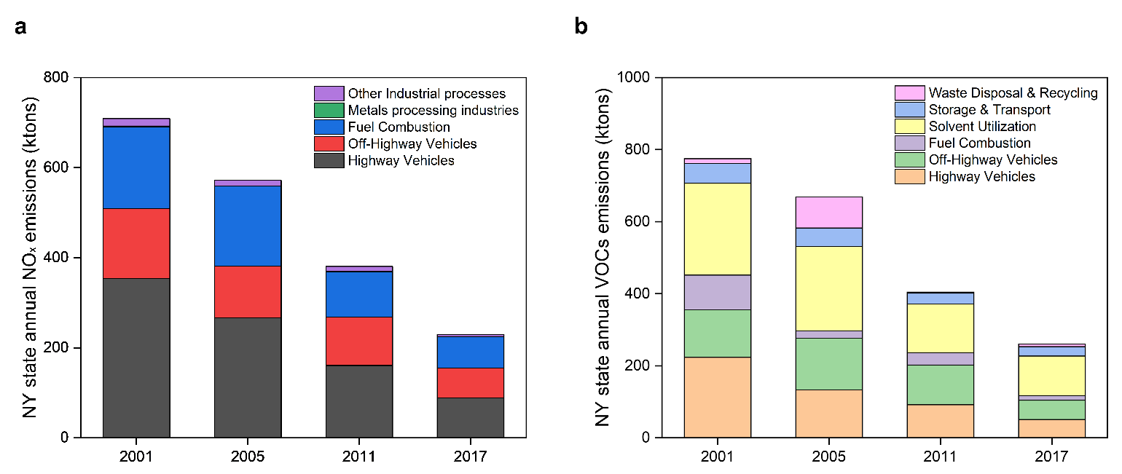
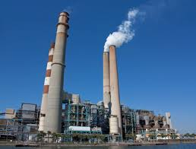
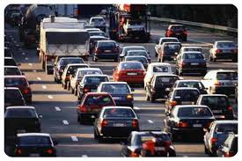

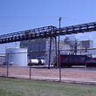
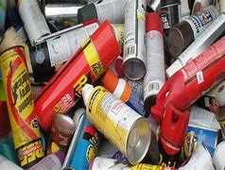
Source for the anthropogenic VOCs and NO_{x}
Air Pollution Chemistry
NYS

Slide 27
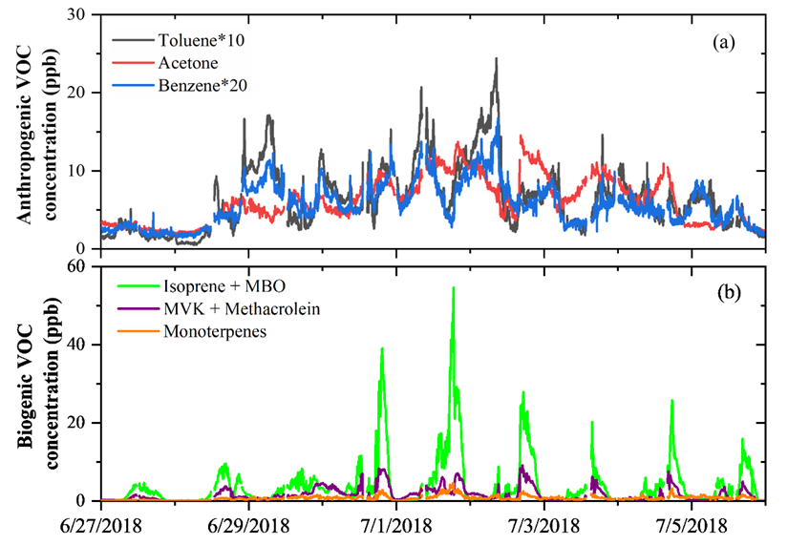
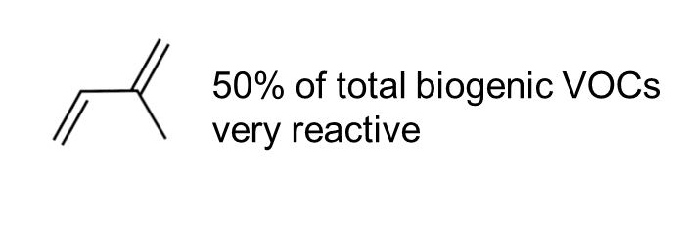
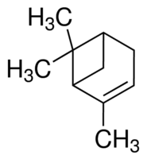
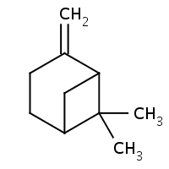
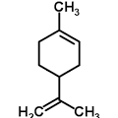
Biogenic VOCs species
Air Pollution Chemistry
Isoprene (C₅H₈)
Terpenes (C₁₀H₁₆)
α-pinene
β-pinene
Limonene

Slide 28
General Chemical Mechanism
Air Pollution Chemistry
Basic chemistry is pretty similar to that for the photooxidation of CO (and CH₄)
Use the shorthand RH for a general VOC compound, where R is an “organic group”
Since there is plenty of NO_{x} in the system for this situation, the chemistry is not too complicated

Slide 29
General Chemical Mechanism (cont)
Air Pollution Chemistry
  RH + OH → R• + H₂O
  R• + O₂ (+ M) → RO₂ + M
  RO₂ + NO → RO + NO₂
  RO + O₂ → R’CHO + HO₂
  HO₂ + NO → OH + NO₂
Allowing the two NO₂ reaction product molecules to photolyze and produce ozone, the net reaction is
NET: RH + 4O₂ → R’CHO + 2 O₃ + H₂O
Note: the R’CHO product is not fully oxidized.

Slide 30
Ozone Production
Air Pollution Chemistry
Since ozone production follows (efficiently in this case) from reactions converting NO to NO₂
P_{O3} = k_{HO2+NO}[HO₂][NO] + k_{RO2+NO}[RO₂][NO]
Making a few reasonable assumptions and eliminating the [HO₂] and [RO₂] from the above equations yields results very much like those for CO oxidation in the low-moderate and high NO_{x} regimes, namely

Slide 31
Ozone Production (cont)
Air Pollution Chemistry
Low-moderate [NO_{x}]:
  P_{O3} ∝ [NO] NO_{x} limited
High [NO_{x}]
  P_{O3} ∝ [RH]/[NO₂] VOC limited
This can be illustrated by something called an ozone isopleth plot

Slide 32
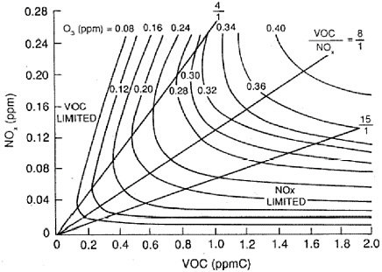
Air Pollution Chemistry
Transition regime
We cannot treat VOC and NO_{X} separately!
In the lower right NO_{X}- limited regime (VOC concentration is much higher than NOX), large changes in VOC have little effect on O₃.
In the upper left VOC-limited regime, lowering NO_{X} can actually increase O_{3.}
Question: Which regime is NYC now?
Transform from VOC-limited/transition regime into NOX-limited at around 2000s

Slide 33
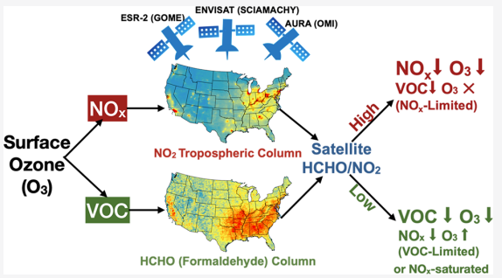
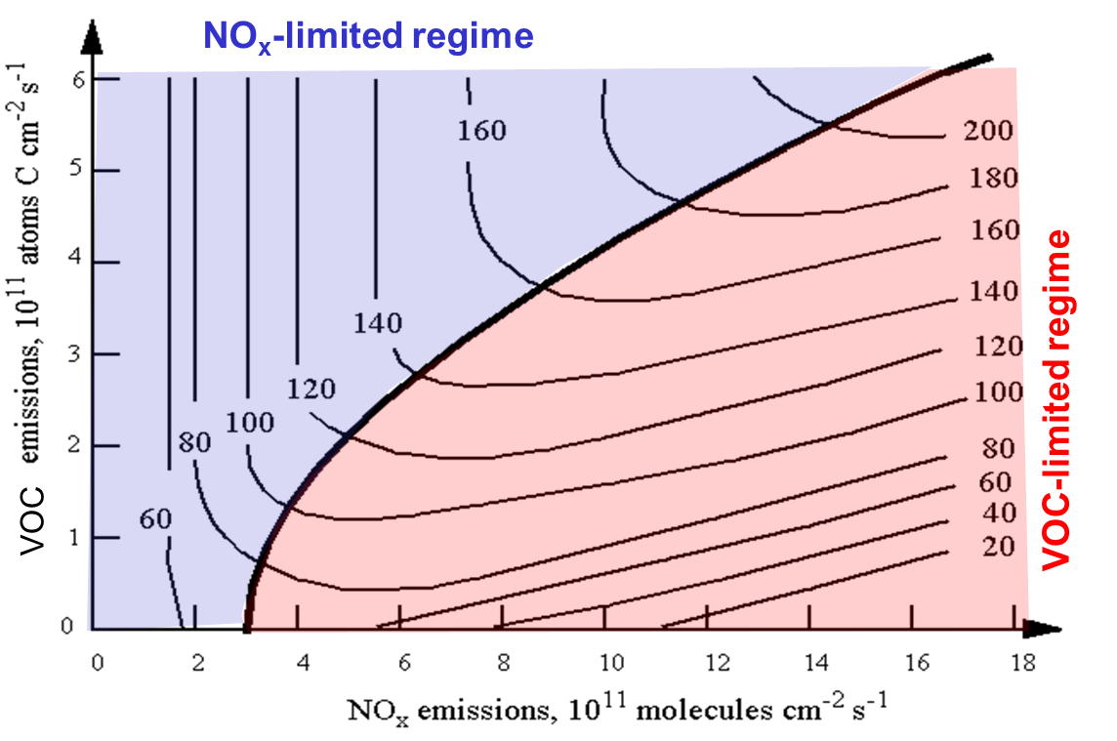
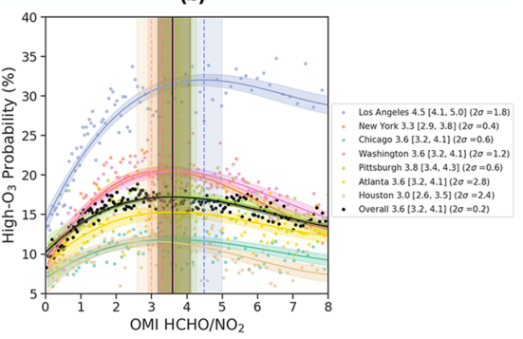
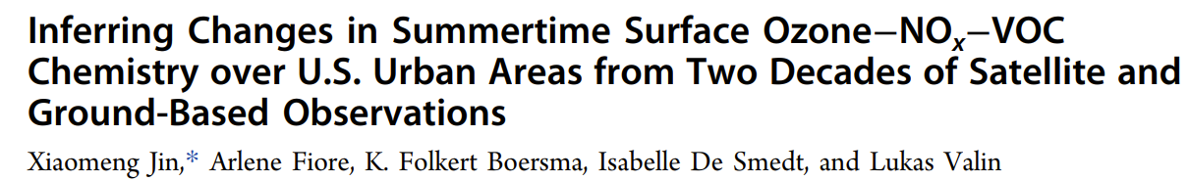
If we do not have accurate measurement for VOC concentrations?
Air Pollution Chemistry
Use emissions (mainly from model)
2020

Slide 34

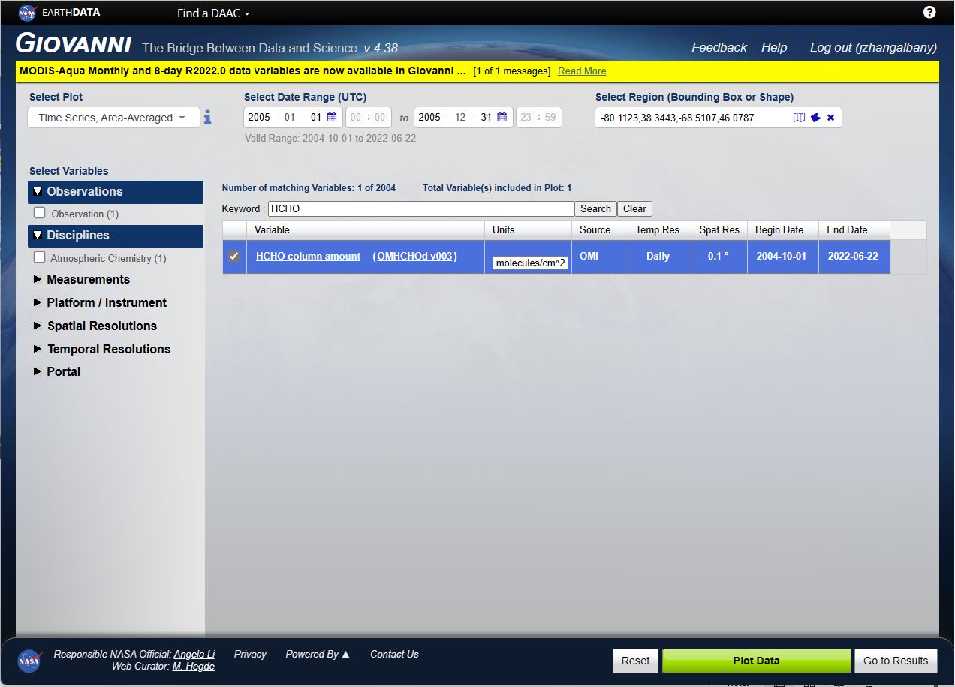
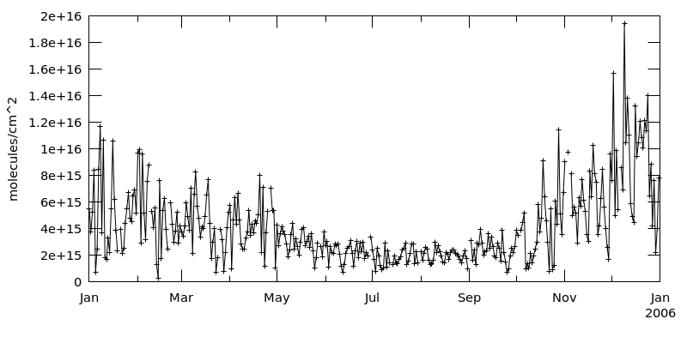
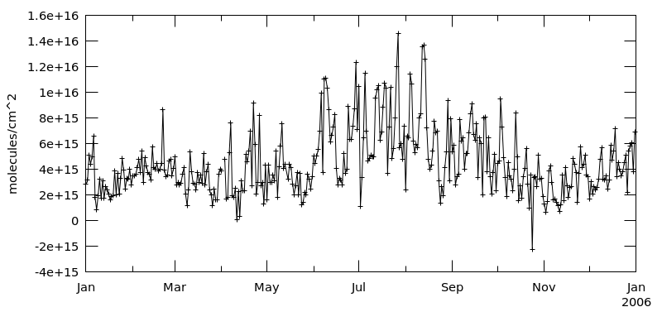
Air Pollution Chemistry

Slide 35
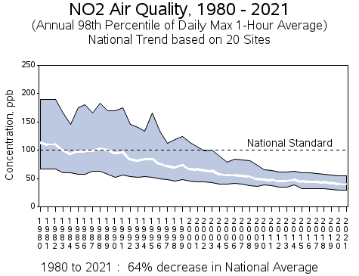
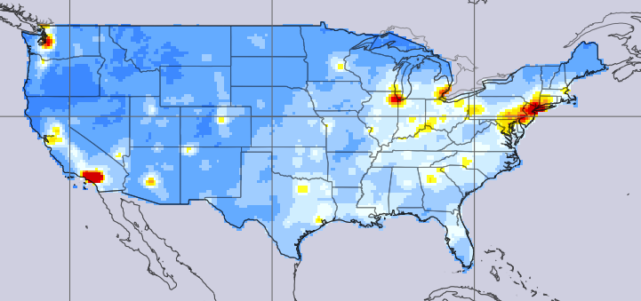
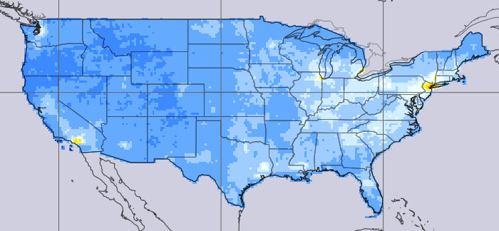

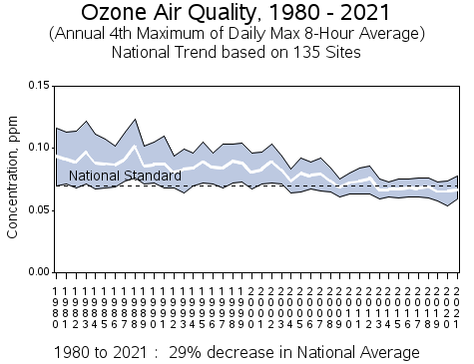
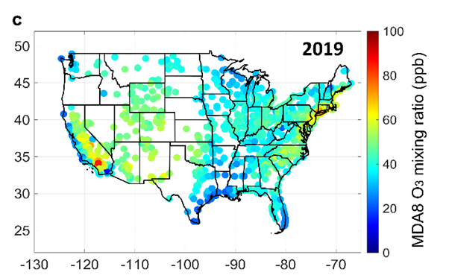
Air Pollution Chemistry: U.S. vs. China emission control
U.S.: Strict emission control policies since the 1970s with amendments in 1990
https://giovanni.gsfc.nasa.gov/giovanni/
2005 summer OMI
2019 summer OMI
VOC-limited/transition NOX-limited
https://www.epa.gov/outdoor-air-quality-data/air-data-concentration-map

Slide 36
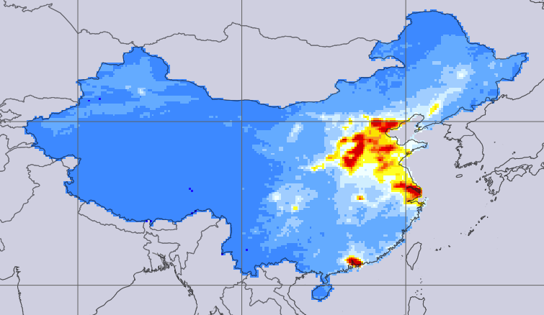

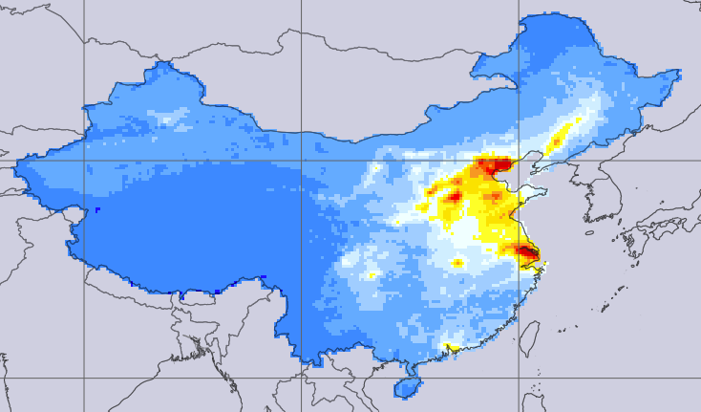
Air Pollution Chemistry: U.S. vs. China emission control
China: Strict emission control policies since 2013
2005 summer OMI
2019 summer OMI
From: Dr. Daniel Jacob
NOx emissions have decreased by 30% since 2013 while VOC emissions have stayed flat.
China is still in VOC-limited regimes now!

Slide 37
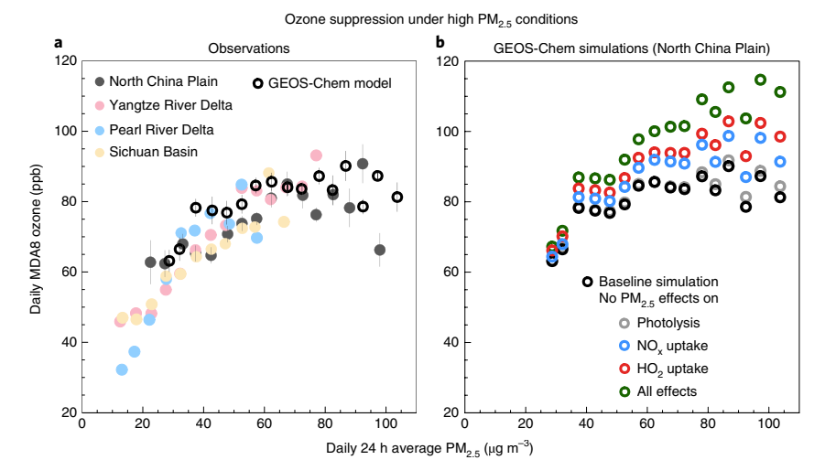
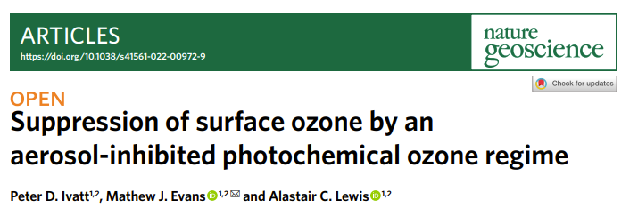
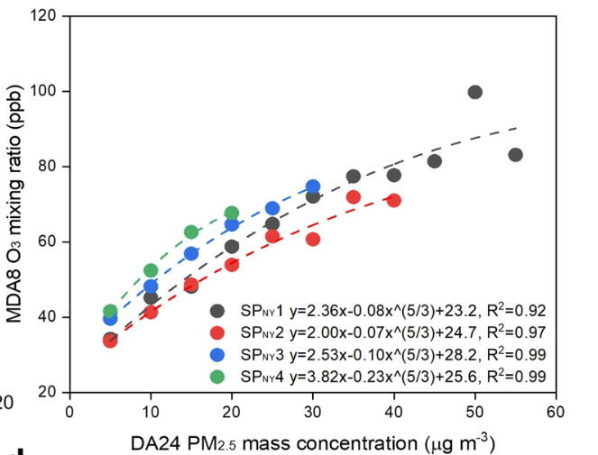
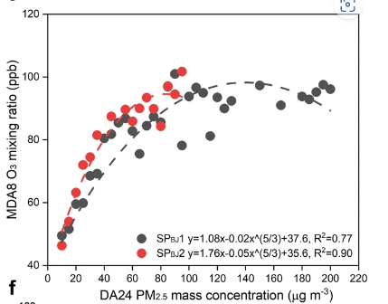
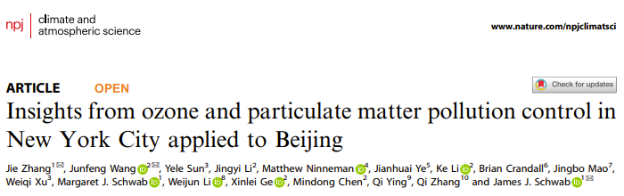
Air Pollution Chemistry: U.S. vs. China emission control
Ivatt et al., 2022, Nature geoscience
NYC
Beijing
Li et al., 2019, Nature geoscience
Any other new findings?
Yes. The suppression effect of PM on Ozone is highlighted
Zhang et al., 2022, npj climate and atmospheric science

Slide 38
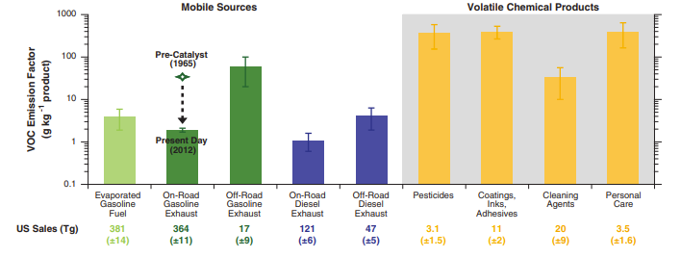
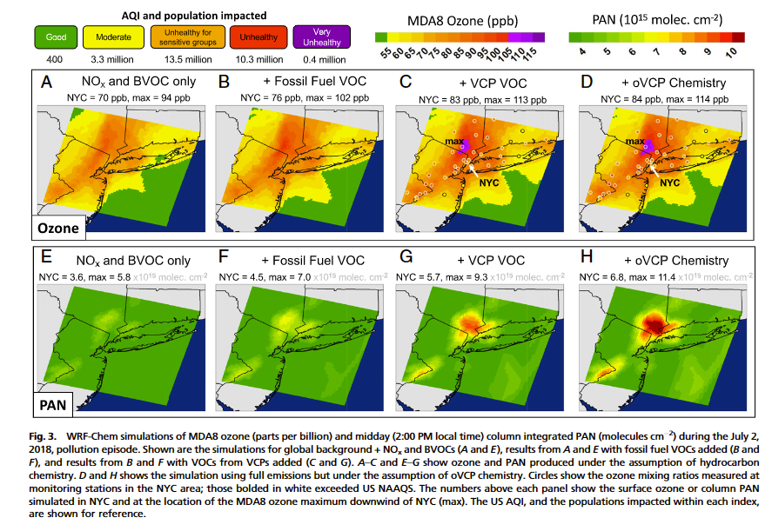
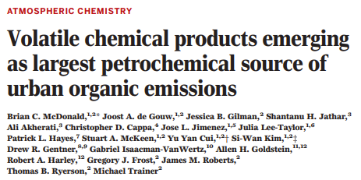
Air Pollution Chemistry
Do we identify all anthropogenic VOCs sources, and clarify their contribution?
Science, 2018: say no
Coggon et al., PNAS, 2021

Slide 39

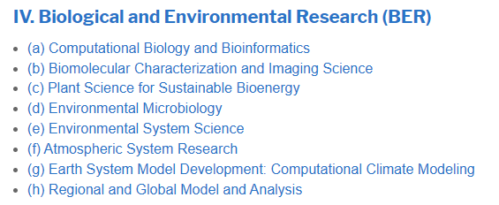
Research award opportunity
https://science.osti.gov/wdts/scgsr?utm_medium=email&utm_source=govdelivery

Slide 40
Key Concepts
Photochemical Oxidation
Ozone, Ozone Production
OH, HO₂, HO_{x}, oxidizer
NO, NO₂, NO_{x}, chemical regime
Photochemical Steady State, NO₂, NO, O₃
Emissions, Air Pollution
Background Troposphere, CO & CH₄
Polluted Atmosphere, VOCs & NO_{x}
Ozone Isopleth Plot

